Slide 2
Sip(session initiation protocol)
Define:
Use to create, modify, terminate multimedia session.
SIP is not a transport protocol and does not actually deliver media, leaving that task to RTP/RTCP.
SIP as used for IMS includes multiple extensions
SIP is a text-based protocol incorporating many elements of HTTP and SMTP.
Notes:
Session: that include voice, video and messaging applications.
SIP is used for signaling and controlling multimedia communication sessions in applications of Internet telephony for voice and video calls, in private IP telephone systems, in instant messaging over Internet Protocol (IP) networks as well as mobile phone calling over LTE (VoLTE).
Extension to deliver instant messages or handle subscriptions to events.
RTP: real time transport protocol
RTCP: RTP Control protocol

Slide 3
Sip(session initiation protocol)
Main goal:
Deliver a session description to a user at their current location.
Deliver new session descriptions to
Modify the characteristics of the ongoing sessions.
Terminate the session whenever the user wants.

Slide 4
Sip(session initiation protocol)
Main Function is to:
Invite user to a communication session(transaction).
Create/Modify/Terminate communication session.

Slide 5
Sip(session initiation protocol)
Provides Services:
User Location
Call Setup
User Availability
User Capabilities
Call Handling
Notes:
US: locates UE location
Call Setup: Ringing and setting information for call between called and calling
User Availability:
User Capatilities: Determine the status and availability of the called subscriber to begin establishing the connection.
Call Handling: forward and terminate call

Slide 6
Sip (session initiation protocol)
SIP works in conjunction with several other protocols:
RSVP (Resource Reservation Protocol)
RTP (Real-time transport Protocol)
RTSP (Real Time Streaming Protocol)
SAP (Session Advertisement Protocol)
SDP (Session Description Protocol)
MIME (Multipurpose Internet Mail Extension)
HTTP (Hypertext Transfer Protocol)
COPS (Common Open Policy Service)
OSP (Open Settlement Protocol)

Slide 7
SIP – ENtities
SIP STRUCTURE
USER AGENT
SERVER CLIENT
Notes:
UA: user device, it communicates and represent the user
SC: A program to accept requests message and send back the respond

Slide 8
SIP Entities
User Agent(UA)
Proxy Server
Redirect Server
Registar Server
Location Server

Slide 9
Sip – proxy server
An intermediate component that acts as both a server and a client
Functionalities:
Receive requests or forward them to another server
Security: using AAA
Routing

Slide 10
SIP – Redirect server
Server that forward session request between different domains without joining transaction process.
Accept SIP request, map the address in the request into a new address and return it to the client

Slide 11
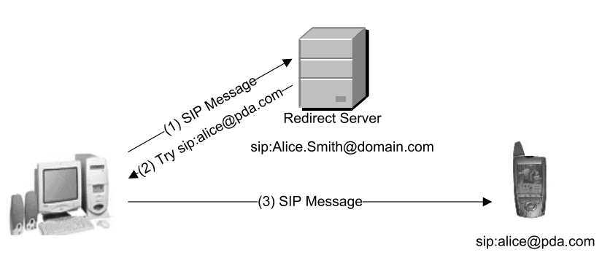

Slide 12
SIP – Registar server
Server accept subscriptions requests
Receive UA register requests and update info about their present location

Slide 13
SIP – location server
Locate the user
Provide information of called for Proxy Server or Redirect Server

Slide 14
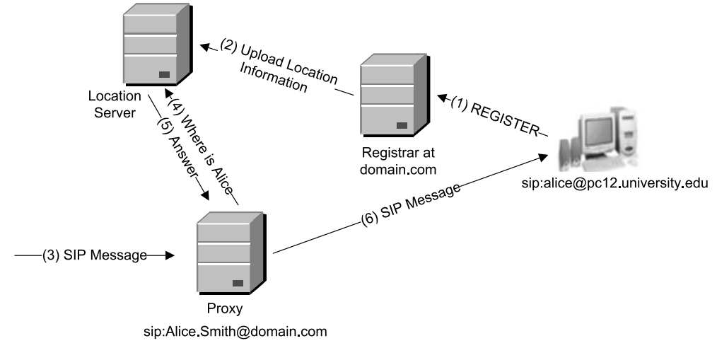

Slide 15
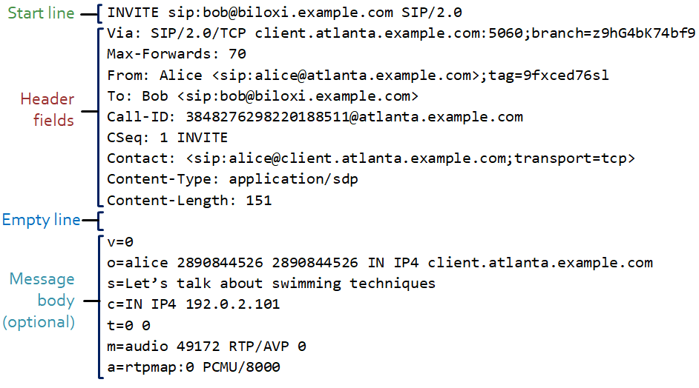
Sip message format
Notes:
SIP is based on HTTP and so it is a textual request-response protocol. Clients send requests, and servers answer with responses. A SIP transaction consists of a request from a client, zero or more provisional responses, and a final response from a server.

Slide 16
Sip message format
Start line:
Request line in requests and status line in responses
Request | Method name, Request – URI , SIP Version
Response | SIP Version, status of the transaction (status code and response- phrase)

Slide 17
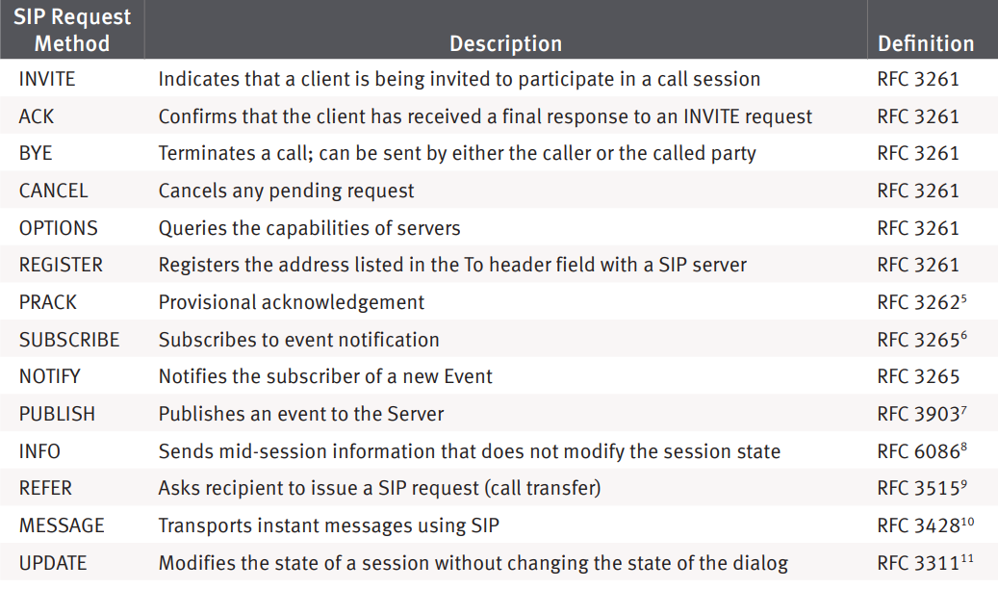
Sip message format
SIP Request Method:

Slide 18
Sip message format
SIP URI:
SIP URI (Uniform Resource Identifier) is a SIP addressing scheme used to call other people through SIP.
SIP URI is the user's SIP number. The SIP URI is the same as the email address.

Slide 19
Sip message format
SIP URI Format:
SIP URI = sip:x@y:Port
x= username/ phone number
y = domain/IP
Example:
sip:joe.bloggs@212.123.1.213 sip:support@phonesystem.3cx.com sip:22444032@phonesystem.3cx.com

Slide 20
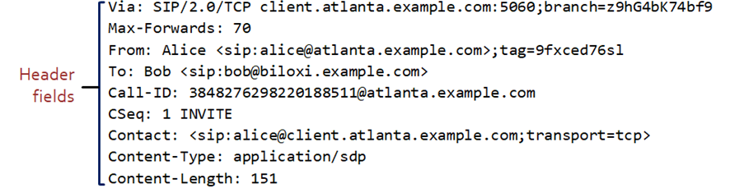
Sip message format
Header field:
A header field consists of the header field’s name, a colon, and the header field’s value.
The six mandatory header fields that appear in every SIP message are: To, From, Cseq, Call-ID, Max-Forwards, and Via.

Slide 21
Sip message format
To | URI of the destination
From | URI of the originator
Cseq | Sequence number, method name
Call - ID | Unique identifier
Max-Forward | Number, avoid routing loops
Via | Keep track of proxies has traversed
Notes:
To,From:mainly used for human consumption and for filtering purposes

Slide 22
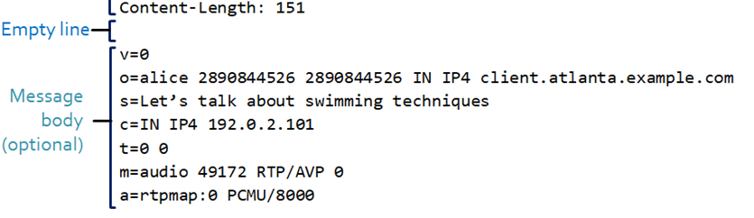
Sip message format
Message Body:
Seperated from header fields by an empty line.
Using MIME encoding.
Transmitted end-to-end.
Notes:
Send email with different formats as
Info: length, format, how to handle

Slide 23
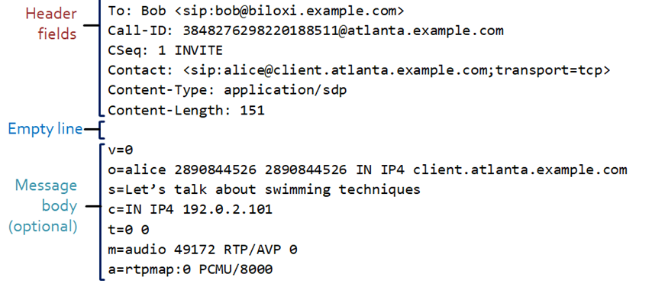
Sip message format
Message Body:
Information about the body is provided in header fields
Notes:
Info: length, format, how to handle
Contact

Slide 24
Sip message format
Content – Encoding | indicate that the listed encoding scheme
Content – Disposition | describe the function
Content – Language | indicate the language
Content – Length | indicate the number of octets
Content – Type | specify the Internet media type
MIME Version | indicate the version of MIME protocol used to construct

Slide 25
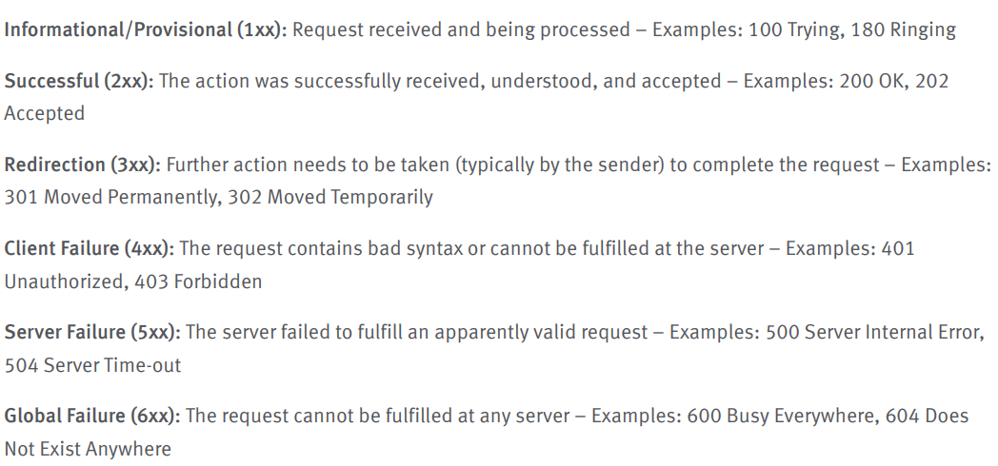
Sip(session initiation protocol)
SIP Respond:

Slide 26
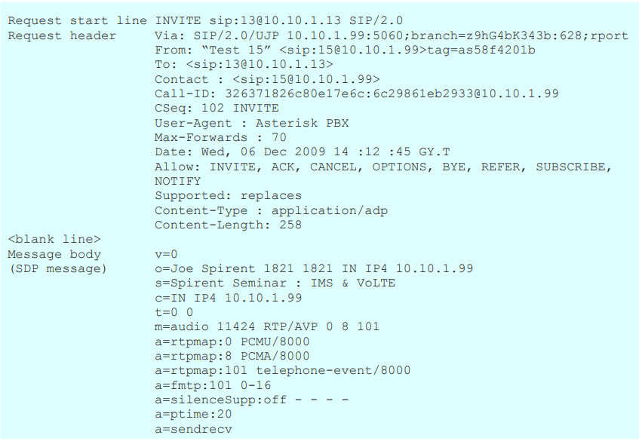
EXAMpLE of sip request

Slide 27
SESSION DESCRIPTION PROTOCOL (SDP)
Designed to be extensible to support new media types and formats.
Include many lines, each line have format:
<character> = <value>
→ <character> is a single case-sensitive alphabetic character.
→ <value> is structured text.

Slide 28
SESSION DESCRIPTION PROTOCOL (SDP)
SDP consists of three main sections:
Session-level description.
Time description.
Media descriptions.

Slide 29
Session description
→ Optional values are specified with =*
v= (protocol version number, currently only 0)
o= (originator and session identifier : username, id, version number, network address)
s= (session name : mandatory with at least one UTF-8-encoded character)
i=* (session title or short information)

Slide 30
Session description
u=* (URI of description)
e=* (zero or more email address with optional name of contacts)
p=* (zero or more phone number with optional name of contacts)
c=* (connection information—not required if included in all media)

Slide 31
Session description
b=* (zero or more bandwidth information lines
z=* (time zone adjustments)
k=* (encryption key)
a=* (zero or more session attribute lines)

Slide 32
Time description
t= (time the session is active)
r=* (zero or more repeat times)

Slide 33
Media description
m= (media name and transport address)
i=* (media title or information field)
c=* (connection information - optional if included at session level)

Slide 34
Media description
b=* (zero or more bandwidth information lines)
k=* (encryption key)
a=* (zero or more media attribute lines - overriding the Session attribute lines)

Slide 35
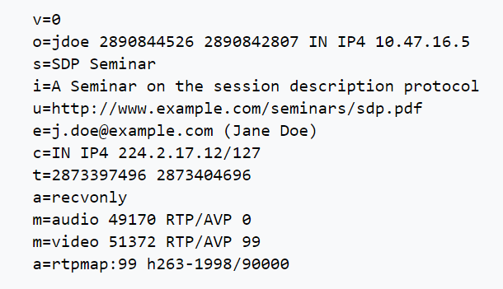
Example sdp message
at IPv4 address 10.47.16.5
This session is originated by the user 'jdoe'
Name is “SDP Seminar”
Connection address specified as IPv4 224.2.17.12
TTL of 127

Slide 36
NOTICE
SDP specification does not incorporate any transport protocol.
It is purely a format for session description.
It is intended to use different transport protocols as necessary including SAP, SIP, and RTCP.

Slide 37
The Real-time Transport Protocol (RTP)
A network protocol for delivering audio and video over IP networks.
Used extensively in communication and entertainment systems that involve streaming media.
RTP typically runs over UDP.

Slide 38
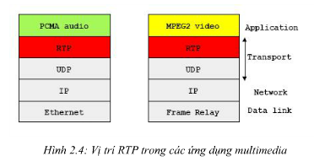
RTP

Slide 39
The Real-time Transport Protocol (RTP)
RTP consists of a data and a control part (RTCP)
- RTP carries the media streams (e.g., audio and video).
- RTCP is used to monitor transmission statistics and quality of service (QoS) and aids synchronization of multiple streams.

Slide 40
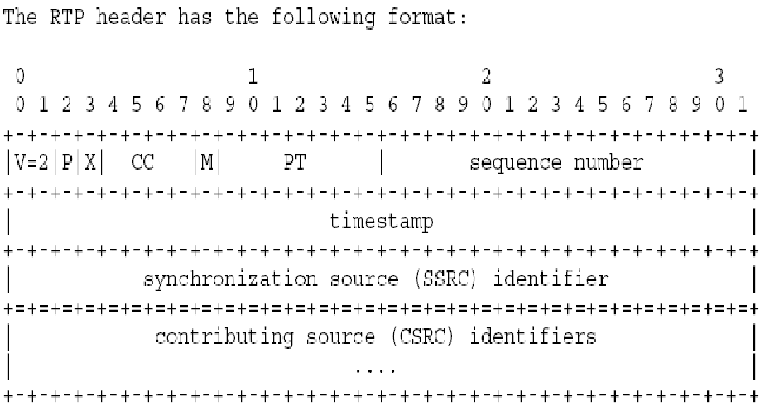
The Real-time Transport Protocol (RTP)
RTP overhead = 12 bytes.

Slide 41
Real-Time Control Protocol (RTCP)
Periodic transmission of control packets to all participants in the session.
Using the same distribution mechanism as the data packets.

Slide 42
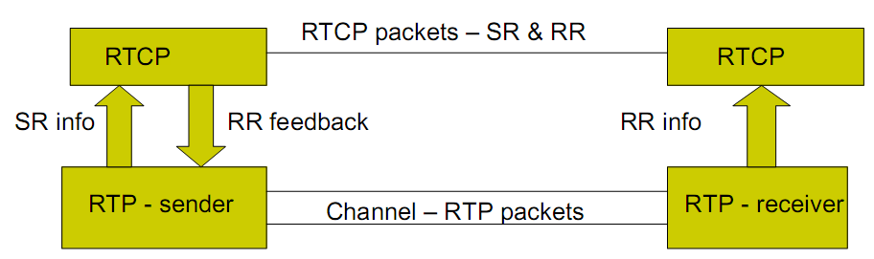
RTCP

Slide 43
RTCP packet
SR – sender report.
RR - Receiver report.
SDES - Source description items
BYE - Indicates end of participation
APP - Application specific functions.

Slide 44
Diameter OVERVIEW
Diameter is an authentication, authorization, and accounting (AAA) protocol for computer networks.
Diameter is successor of RADIUS protocol that run over UDP.
Notes:
Diameter ra đời năm 1996, dựa trên giao thức RADIUS
Hỗ trợ VPN, VoIP, Mobile IP, Fax Over IP, quản lý tài nguyên.
Sử dụng giao thức truyền tải: TCP và SCTP

Slide 45
Diameter OVERVIEW
IMPROVEMENTS over RADIUS:
+ Reliable + Audit-ability
+ Transport Layer Security + Roaming Support
+ Fail-over Mechanism + Agent Support
+ Server Initiated Messages
+ Transition Support
+ Peer Discovery & Configuration
+ Capability Negotiation

Slide 46
Diameter OVERVIEW
Diameter have 3 main components:
Diameter Client.
Diameter Server.
Diameter Agent.
Notes:
Client: This is a functional entity, which performs access control.
Server: This is a functional entity that handles authentication, authorization, and accounting requests for a particular realm.
Realm. This is an administrative domain.
Proxy: This is a functional entity that, forwarding Diameter messages, makes policy decisions relating to resource usage and provisioning, modify messages to implement policy decisions.
Relay: This is a functional entity that forwards Diameter messages, based on routing-related information and realm-routing table entries.
Redirect agent: This is a functional entity that refers clients to servers and allows them to communicate directly.
Translation agent: This is a functional entity that performs protocol translation between Diameter and other AAA protocols, such as RADIUS.
Client là thiết bị ở biên, truy vấn và sử dụng dịch vụ
Agent đóng vai trò như Relay, Proxy, Redirect và dịch vụ các yêu cầu
- Server quản lý và xử lý các yêu cầu AAA.

Slide 47
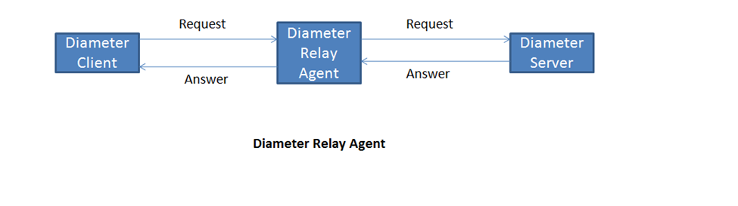
Diameter OVERVIEW
Diameter Relay Agent
Notes:
- Relay Agents are diameter agents that accept requests and route messages to other Diamater nodes based on information found in messages.
- This is known as the routing table.

Slide 48
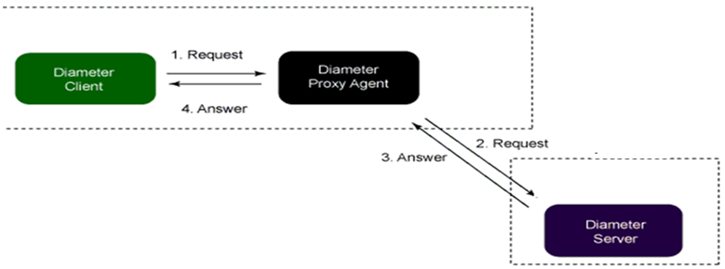
Diameter OVERVIEW
Diameter Proxy Agent
Notes:
Similar to relays, proxy agents route Diameter messages using Diamter routing table.
Difference is that thay modify messages to implement policy enforcement.

Slide 49
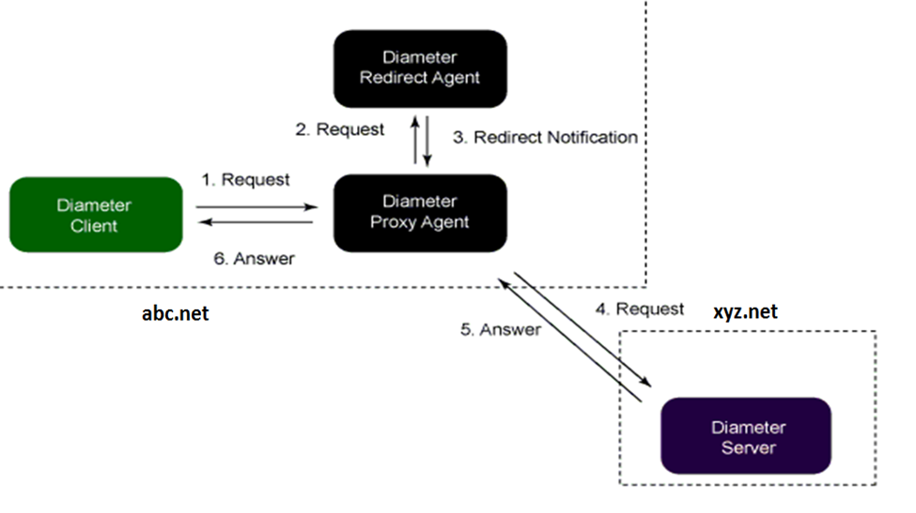
Diameter OVERVIEW
Diameter Redirect Agent
Notes:
Redirect agents are useful in scenarios where the Diameter routing configuration need to be centralized

Slide 50
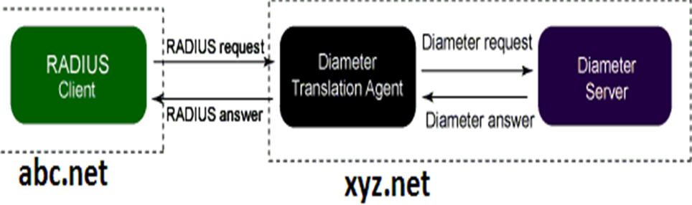
Diameter OVERVIEW
Diameter Translations Agent
Notes:
A translation agent is a device that provides translation between two protocols.
Translation agents are likely to be used as aggregation servers to communicate with a Diameter infrastructure, while allowing for the embedded systems to be migrated at a slower pace.

Slide 51
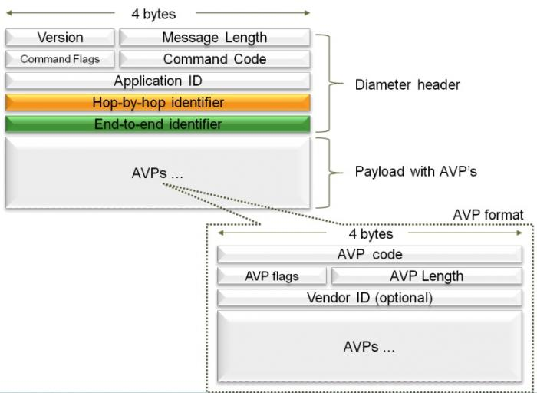
DIAMETER OVERVIEW
- Diameter messages are either requests or answers.

Slide 52
DIAMETER OVERVIEW
Diameter is a peer-to-peer protocol, rather than the common client/server protocol.
- Diameter client is a functional entity that performs access control
- Diameter server is the functional entity that performs authentication and authorization.
- Both a Diameter client and a Diameter server can send or receive requests and responses.

Slide 53
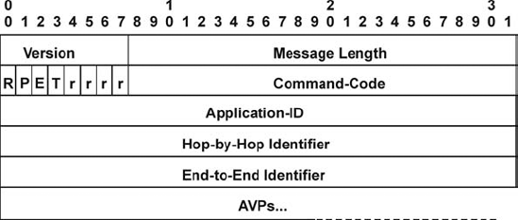
DIAmeter header

Slide 54
DIAmeter header
Version
This Version field MUST be set to 1 to indicate Diameter Version 1.
Message Length
Contain the length of Message Header + (Data) Avp

Slide 55

DIAmeter header
Command Flags
The Command Flags field is eight bits.
Retransmits, indicates on failure on retransmission that this request is a retransmitted messaged
Request, if set message is a request, else an answer
Proxiable, indicates that request is proxiable
Reserved must be 0
Answer is a protocol error with result code 3xxx
Notes:
Command Flag: 8bit, dạng RPETrrrr
R: 1: yêu cầu; 0: trả lời
P: Proxiable, 1: Proxy, Redirect, Relay; 0: xử lý tại nút
E: Error, 1: lỗi giao thức trong bản tin đáp ứng. 0: trong bản tin yêu cầu, không lỗi
T: Transmittion:1: liên kết bị đứt, bản tin yêu cầu bị trùng hoặc không có trả lời từ Server
r: dự trữ

Slide 56
DIAMETER AVP
AVP: Atrribute Value Pair
AVP contains AVP Header and AVP Data

Slide 57
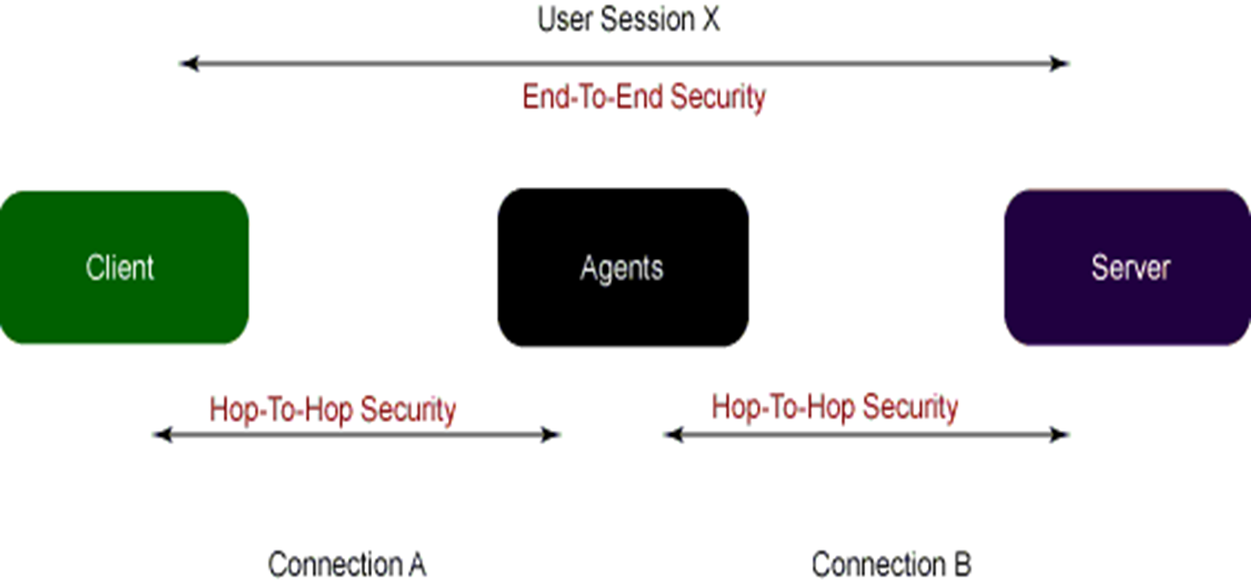
SECURITY in DIAMETER
IPSec, TLS, PAP, CHAP

Slide 58
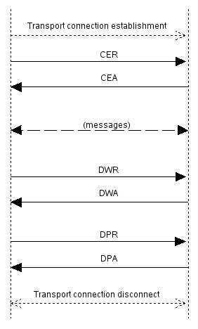
Connection in diameter

Slide 59
AAA in diameter
Tart_record
Interim_record
Stop_record
Notes:
Cung cấp chế độ bảo mật
Cung cấp thông số ngẫu nhiên phục vụ bảo mật thông tin chứng thực
Chức năng tính phí

Slide 60
H.248 / megaco
H.248/MEGACO is a Gateway Control Protocol.
It implementation of the media gateway control protocol architecture for providing telecommunication services across a converged internetwork.
Notes:
It implementation of the media gateway control protocol architecture for providing telecommunication services across a converged internetwork, consisting of the traditional public switched telephone network (PSTN) and modern packet networks, such as the Internet.

Slide 61
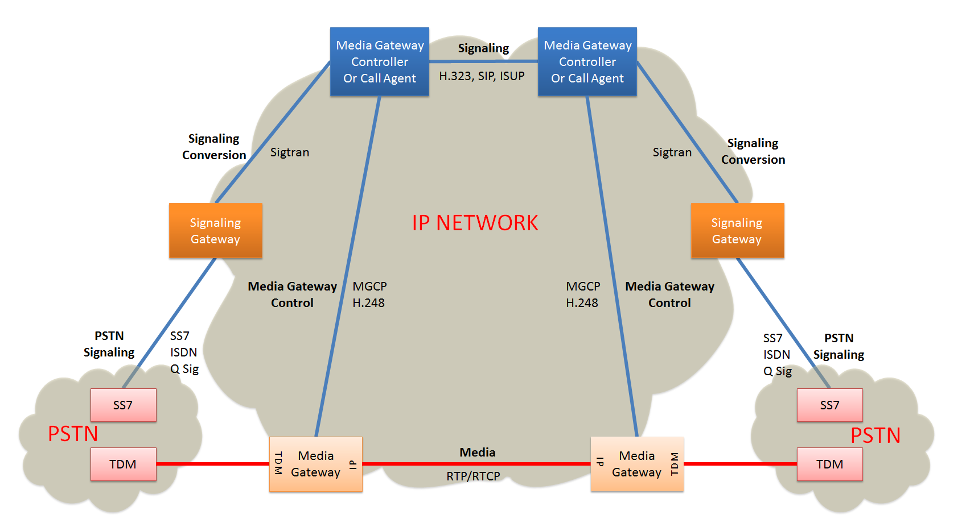
H.248 / megaco
Converged Network Architecture
Notes:
< Converged Network Architecture>

Slide 62
H.248 / megaco
This architecture is composed of:
The media gateway controller (MGC) and the media gateways (MGs).
Call control functionality is distributed between an MGC and an MG
Notes:
The media gateway controller (MGC) and the media gateways (MGs).
Call control functionality is distributed between an MGC (manages the establishment and destroy of call) and an MG (responds to the MGC request and handle processes media streams).

Slide 63
H.248 / megaco
H.248/Megaco don’t describe the establishment of calls.
H.248/Megaco is used for communication downward
The architecture requires other protocols for communication between multiple MGCs.
Notes:
H.248/Megaco don’t describe the establishment of calls across domains or across media gateway controllers. H.248/Megaco is used for communication downward, to the media gateways but not constitute a complete system. The architecture requires other protocols for communication between multiple MGCs.

Slide 64
Dns/enum dns (Domain name system)
DNS is a database, storage domain name and their corresponding IP addresses
Each entry is referred to as a Resource Record (RR).
Misson: Convert domain name to IP address corresponding.
Notes:
DNS is a database storage domain name and their corresponding IP addresses, of every registered system on a TCP/IP network, such as the Internet or the IMS. Each entry is referred to as a Resource Record (RR).
when entering a domain name, DNS will convert the domain name into IP address for the browser to understand and access the website. It is mission of DNS, so users don’t need enter IP address then visiting the website.

Slide 65
Dns/enum dns (Domain name system)
The Naming Authority Pointer (NAPTR) DNS RR
NAPTR is a type of resource record in the DNS of the Internet.
NAPTR RRs are used to replace compact, regular expressions to a replacement field that may well be a pointer to another rule.
The DNS-type code for NAPTR is 35.Service records (SRV RRs)

Slide 66
Dns/enum enumn (E.164 Number to uri mapping)
ENUM is a protocol, uses the special DNS record (NAPTR) to translate a telephone number into a URI (Uniform Resource Identifier) or a IP address.
On the other hand, ENUM is a technology that can be used to connect traditional telecommunication systems to the new Internet communications system
Notes:
ENUM stands for E.164 Number to URI Mapping.
ENUM is a protocol develop by the IETF that uses the special DNS record (NAPTR) to translate a telephone number into a URI (Uniform Resource Identifier) or a IP address.
On the other hand, ENUM is a technology that can be used to connect traditional telecommunication systems to the new Internet communications system. ENUM can therefore be considered as an important element of the communications industry in converting voice and data transmission from traditional telecommunication networks to Internet transmission.

Slide 67
Dns/enum enumn (E.164 Number to uri mapping)
ENUM algorithm:
1. Remove all characters with the exception of the digits. For example, given the E.164 number "+44-20-7946-0148" (which would then have been converted into an AUS of +442079460148"), this step would simply remove the leading '+', producing "442079460148".
2. Reverse the order of the digits. Example: "841064970244"
3. Put dots ('.') between each digit. Example: "8.4.1.0.6.4.9.7.0.2.4.4"
4. Append the string ".e164.arpa." to the end and interpret as a domain name.
Example: 8.4.1.0.6.4.9.7.0.2.4.4.e164.arpa.

Slide 68
Identification in ims
IDENTIFICATION
USER IDENTITY
SERVICE IDENTITY

Slide 69
User identity
Why?
Must be possible to uniquely identify users in network.
Allows a particular phone to ring
Notes:
Session: that include voice, video and messaging applications.
SIP is used for signaling and controlling multimedia communication sessions in applications of Internet telephony for voice and video calls, in private IP telephone systems, in instant messaging over Internet Protocol (IP) networks as well as mobile phone calling over LTE (VoLTE).
Extension to deliver instant messages or handle subscriptions to events.
RTP: real time transport protocol
RTCP: RTP Control protocol

Slide 70
PUBLIC USER IDENTITY
Use to route SIP signaling (request communication to another user)
An IMS user has one or more public user identities.

Slide 71
PUBLIC USER IDENTITY
Offer interesting concept:
A set of implicitly registered public user identities
Possible to register several Public User Identities in one message.
Saving time and bandwidth
Notes:
An implicit registration set is a group of public user identities that are registered via a single registration request.
1 public user identity is registered -> all registered
1 public user identity is de-registered -> all de-registered
Similarly, when one of the public user identities within the set is de-registered, all public user identities that have been implicitly registered are de-registered at the same time.

Slide 72
PUBLIC USER IDENTITY - form
FORM
SIP URI
TEL URI

Slide 73
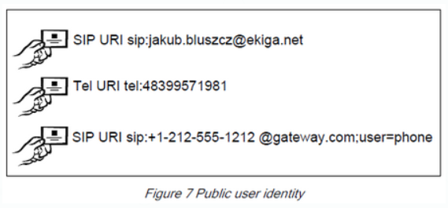
Sip uri
The form when containing SIP URI is sip:username@domain
Can include a telephone number in a SIP URI:
sip:+1-212-555-0293@operator.com

Slide 74
tel uri
The form when containing TEL URI: tel:+<CC><NDC><SN> or
tel:<Global Number>
Example
tel:+1-212-555-0293

Slide 75
tel uri
TEL URIs are needed:
To make a call from an IMS terminal to a PSTN phone, because PSTN numbers are represented only by digits.
If a PSTN subscriber wants to make a call to an IMS user, because a PSTN user can only dial digits.

Slide 76
Wildcarded public user identity
Stored in the HSS
Includes the delimiter character to indicate the extent of the part of the Public User Identity that is wildcarded.
Represent a collection of Public User Identities that share the same service profile and are included in the same implicit registration set.

Slide 77
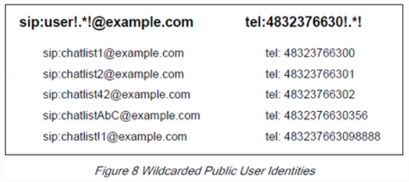
Wildcarded public user identity
Takes the form of Extended Regular Expressions (ERE).
The delimiter is the exclamation mark character (“!”).

Slide 78
Private USER IDENTITY
Each IMS subscriber is assigned a Private User Identity.
Assigned by the home network operator.
Use for subscription identification and authentication purposes.
Not use for routing SIP requests
Notes:
used, for example, for Registration, Authorisation, Administration, and Accounting purposes.

Slide 79
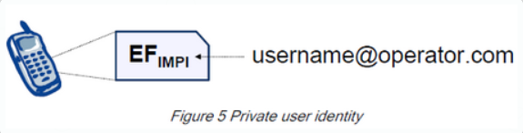
Private USER IDENTITY
Take the format of an NAI (Network Access Identiﬁer):
username@operator.com.
Stored in HSS and ISIM

Slide 80
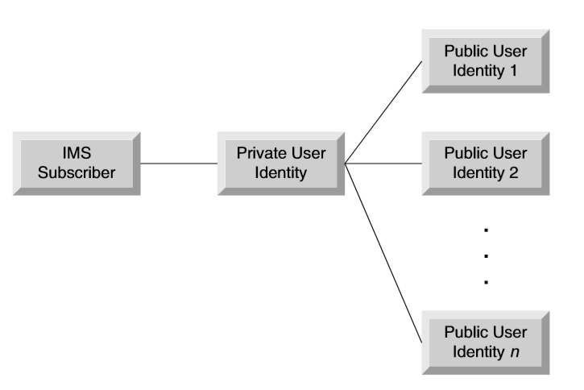
Relation between public user identity and private user identity

Slide 81
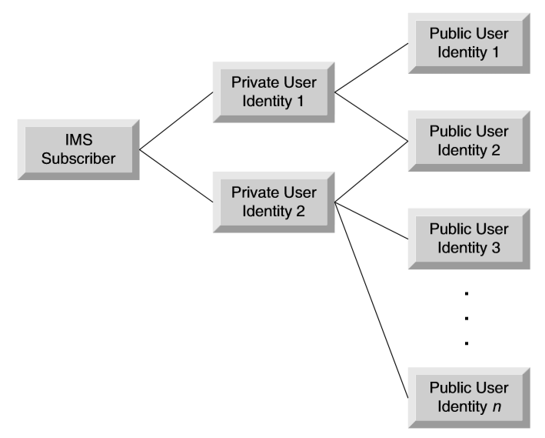
Relation between public user identity and private user identity

Slide 82
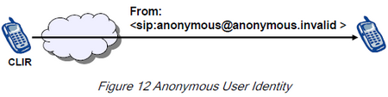
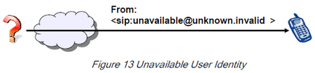
Anonymous User Identity:
Unavailable User Identity:
Notes:
In case of terminating signalling the “From” header may contain an Anonymous User Identity, which means that the calling party desired anonymity.
In case of terminating signalling the “From” header may contain an Unavailable User Identity, which means that the calling party is unknown.

Slide 83
Public service identity (PSI)
With the introduction of standardized presence, messaging, conferencing, and group service capabilities in IM CN subsystem
There is a need for Public Service Identities (PSIs).
Notes:
Why?
This is because the Private User Identity is used for user authentication purposes.

Slide 84
Public service identity (PSI)
An identity identifies a service, or a specific resource created for a service on an AS.
Use to identify groups (chat-type service)
Take the format of a SIP URI or a TEL URI.
Do not have an associated Private User Identity.
PSIs are not applicable to users.
Notes:
For example a chat-type service may use a PSI (e.g. sip: chatlist_X@example.com) to which the users establish a session to be able to send and receive messages from other session participants.

Slide 85
Private service identity
Applicable for PSI User
Take form of NAI
Enables Public Service Identities to be associated to a Private Service Identity which is required for compatibility with the Cx (HSS-CSCF) procedures.

Slide 86
Wildcarded Public service identity
PSIs stored in HSS as distinct PSI or wildcarded PSI
Represents a collection of PSIs.
Enable optimization of the O&M of the nodes.
Take same format as Wildcarded Public User Identity

